Slide 1
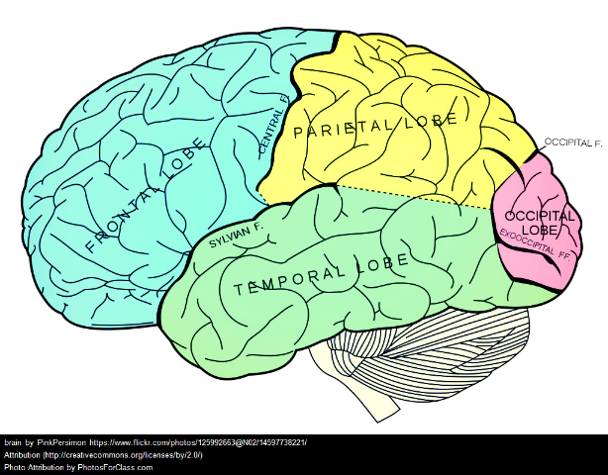
Middle Schoolers Have Plastic Brains
Part 2
June 30, 2015
Kimberly Lewis
“It’s All About the Team”
NYSMSA 2nd Annual Regional Conference

Slide 2
Kim
Teacher
Learner
Trainer

Slide 3
Kim’s Top Tips & Strategies
2. Shift the Focus
FINISHED PRODUCT
Positive, objective, timely, reliable
Open-ended questions
Student’s task is to plan for improvement

Slide 4
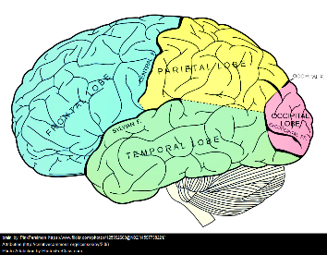
Kim’s Top Tips & Strategies
2. Shift the Focus
STUDENT
Executive Function
Self Regulating
Self-Managing
Self- Monitoring
Self Modifying
Help them OWN
their learning

Slide 5
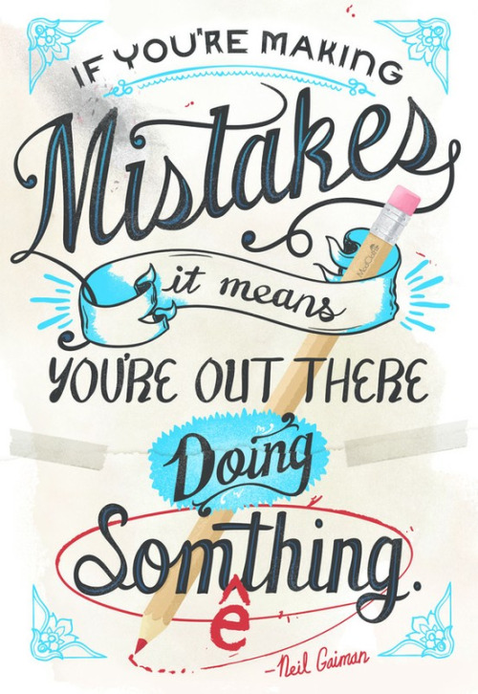
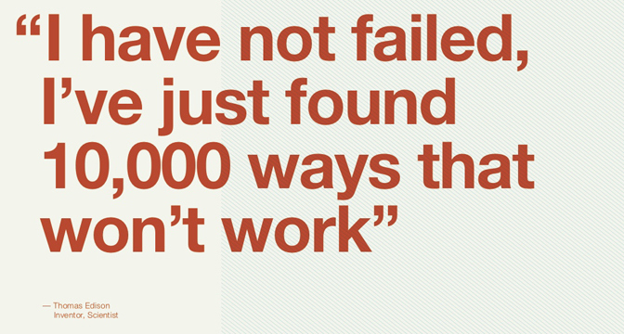
Kim’s Top Tips & Strategies
3. Take them to the Pit

Slide 6
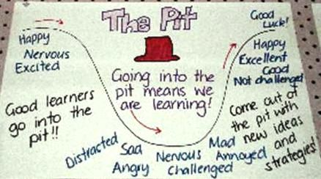
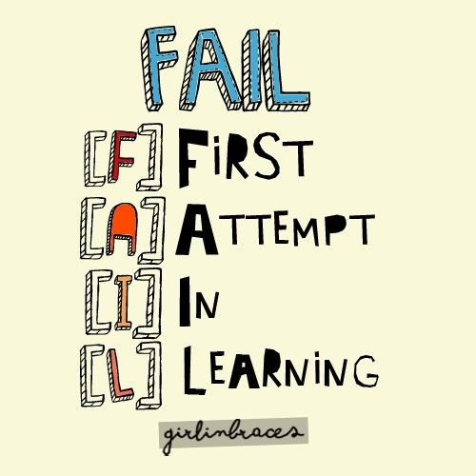
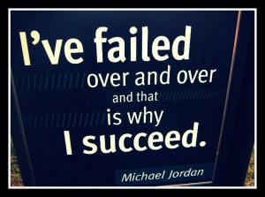
Kim’s Top Tips & Strategies
3. Take them to the Pit

Slide 7
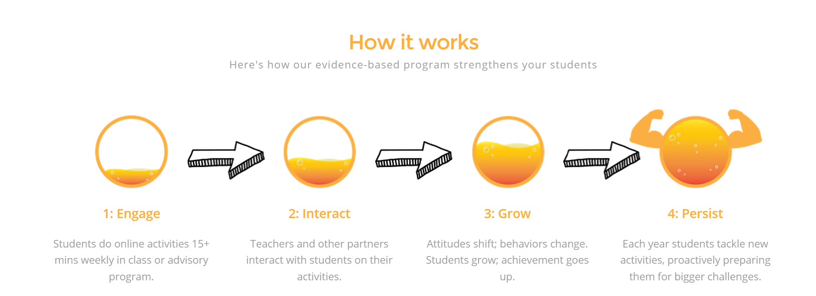
Kim’s Top Tips & Strategies
3. Take them to the Pit…&…
Lead them OUT!
WVCS
2015-16
Grades 6-8
Will you partner with us?
Teach them
resilience

Slide 8
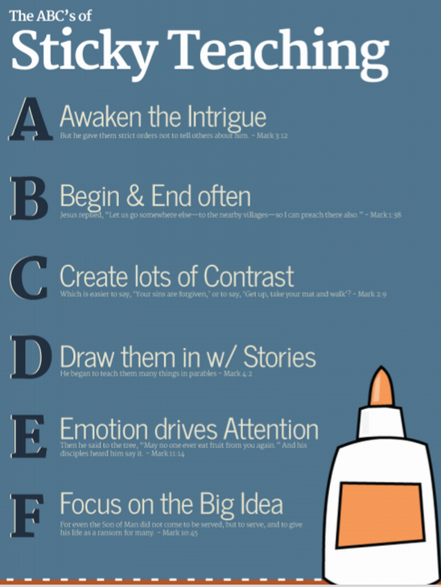
Kim’s Top Tips & Strategies
4. Engage the Brain
15 seconds
TEACH LIKE A PIRATE
Passion
Immersion
Rapport
Ask & Analyze
Transformation
Enthusiasm
Dave Burgess, 2012

Slide 9
Working Memory
Kim’s Top Tips & Strategies
5. Train the Brain
Visualize It
Teach It
MOVE IT-
MOVE IT!
Categorize It
Connect It!
Laugh!
Have fun!
Make It
“DIFFERENT”
Eat
Fruits,
Veggies
& Dark
Chocolate
Add MUSIC
Learn SOMETHING New
Take your Brain
“to the Gym”

Slide 10
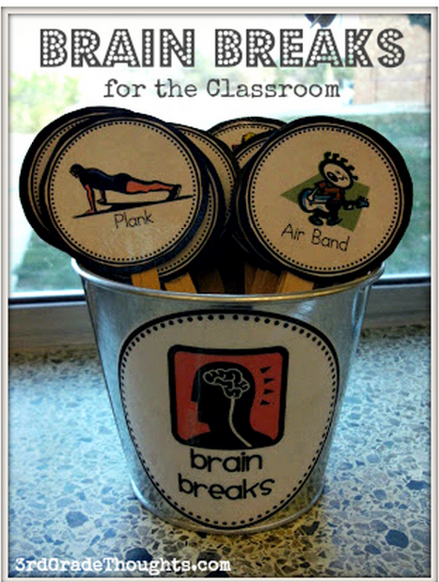
Kim’s Top Tips & Strategies
5. Train the Brain
Class Tips
10:2 Ratio
CHUNKING

Slide 11
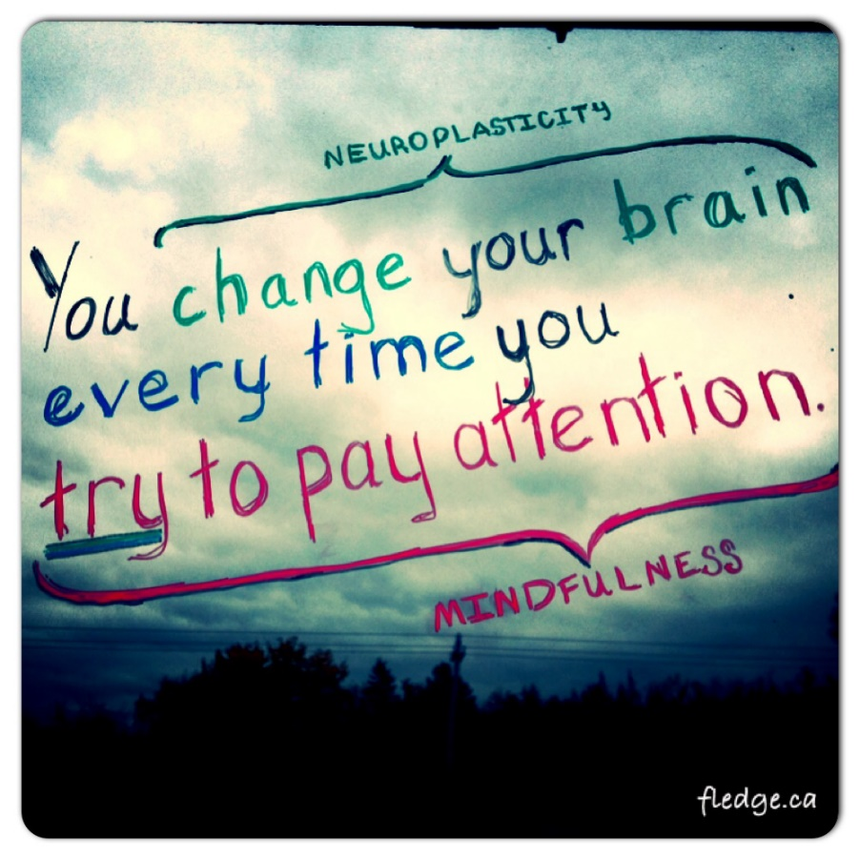
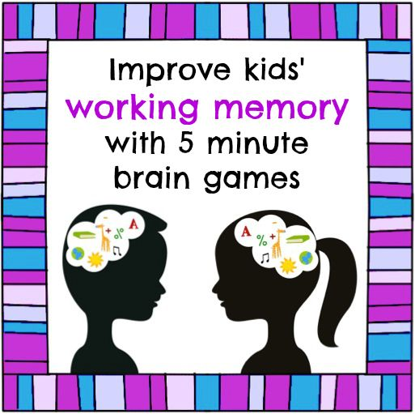
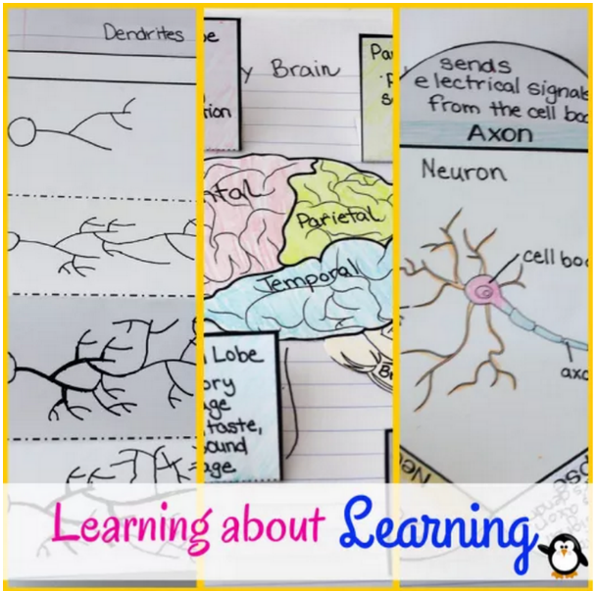
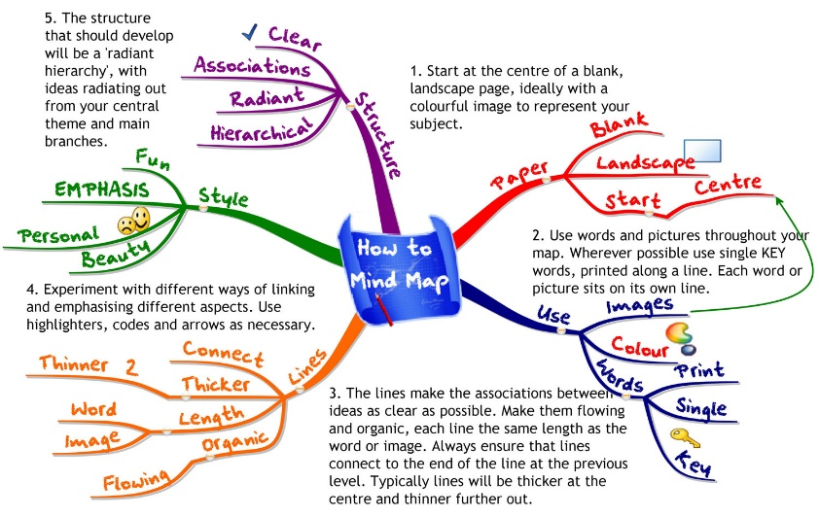
Kim’s Top Tips & Strategies
5. Train the Brain
Class Tips
Mindfulness
SINGLE
TASKing

Slide 12
The END
The BEGINNING

Slide 13
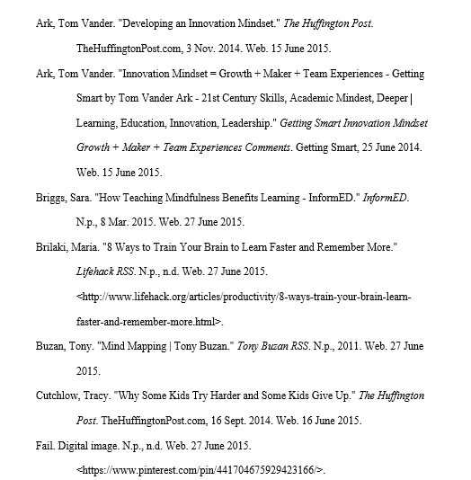
Works Cited

Slide 14
Works Cited, continued

Slide 15
Works Cited, continued

Slide 16
Works Cited, continued

