Slide 1
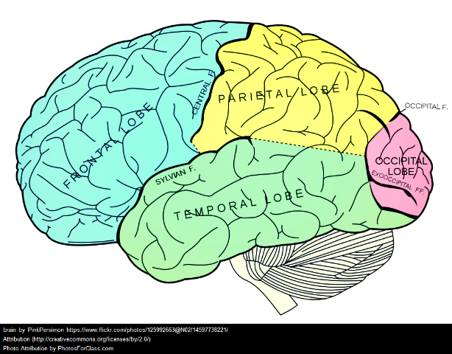
Middle Schoolers Have Plastic Brains
Part 1
June 30, 2015
Kimberly Lewis
“It’s All About the Team”
NYSMSA 2nd Annual Regional Conference

Slide 2
Kim
Teacher
Learner
Trainer

Slide 3
Make it Interactive
Join Session:

Slide 4
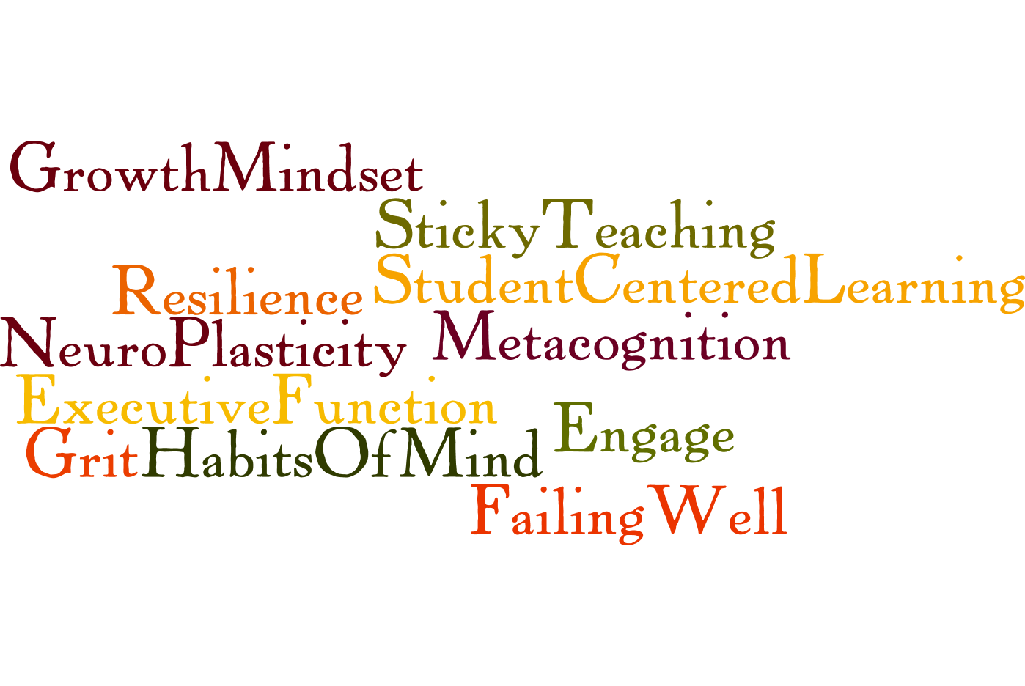

Slide 6
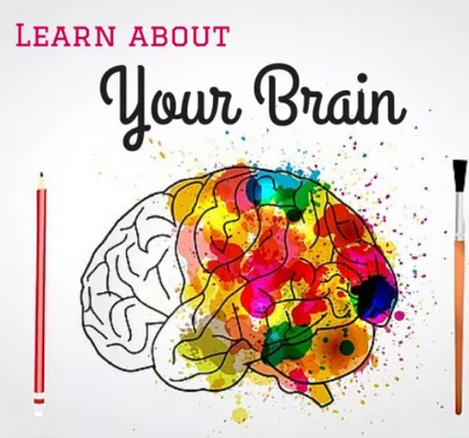

Slide 7
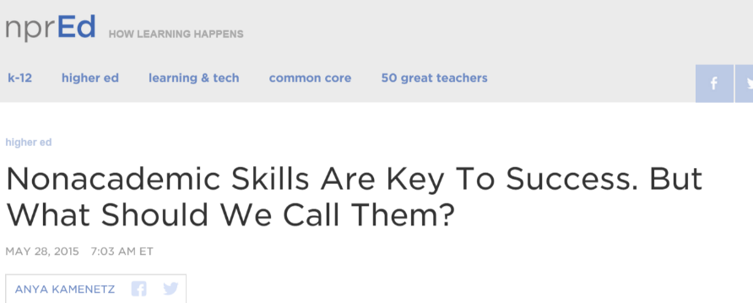
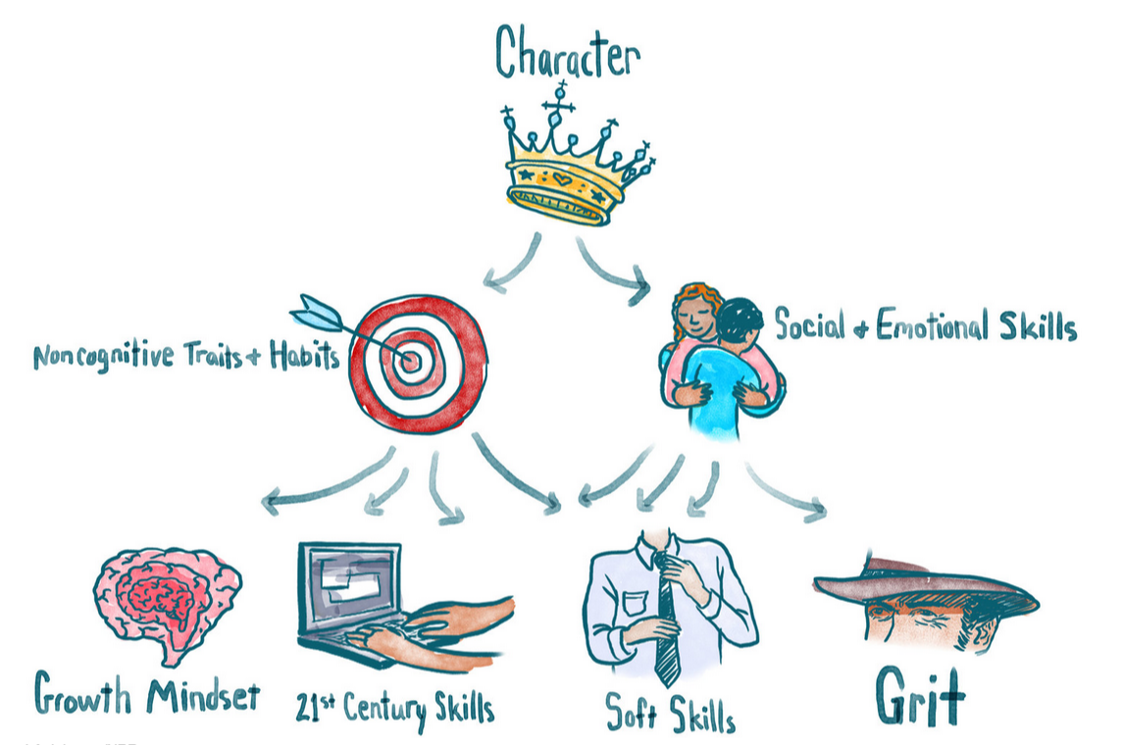

Slide 8
Follow & Learn
WholeBrainTeaching
Mindfulness
Lance King
http://akordingtokim.weebly.com/

Slide 9
Kim’s Top Tips & Strategies
Model Mindset
Shift the Focus
Take them to the Pit
Engage the Brain
Train the Brain

Slide 10
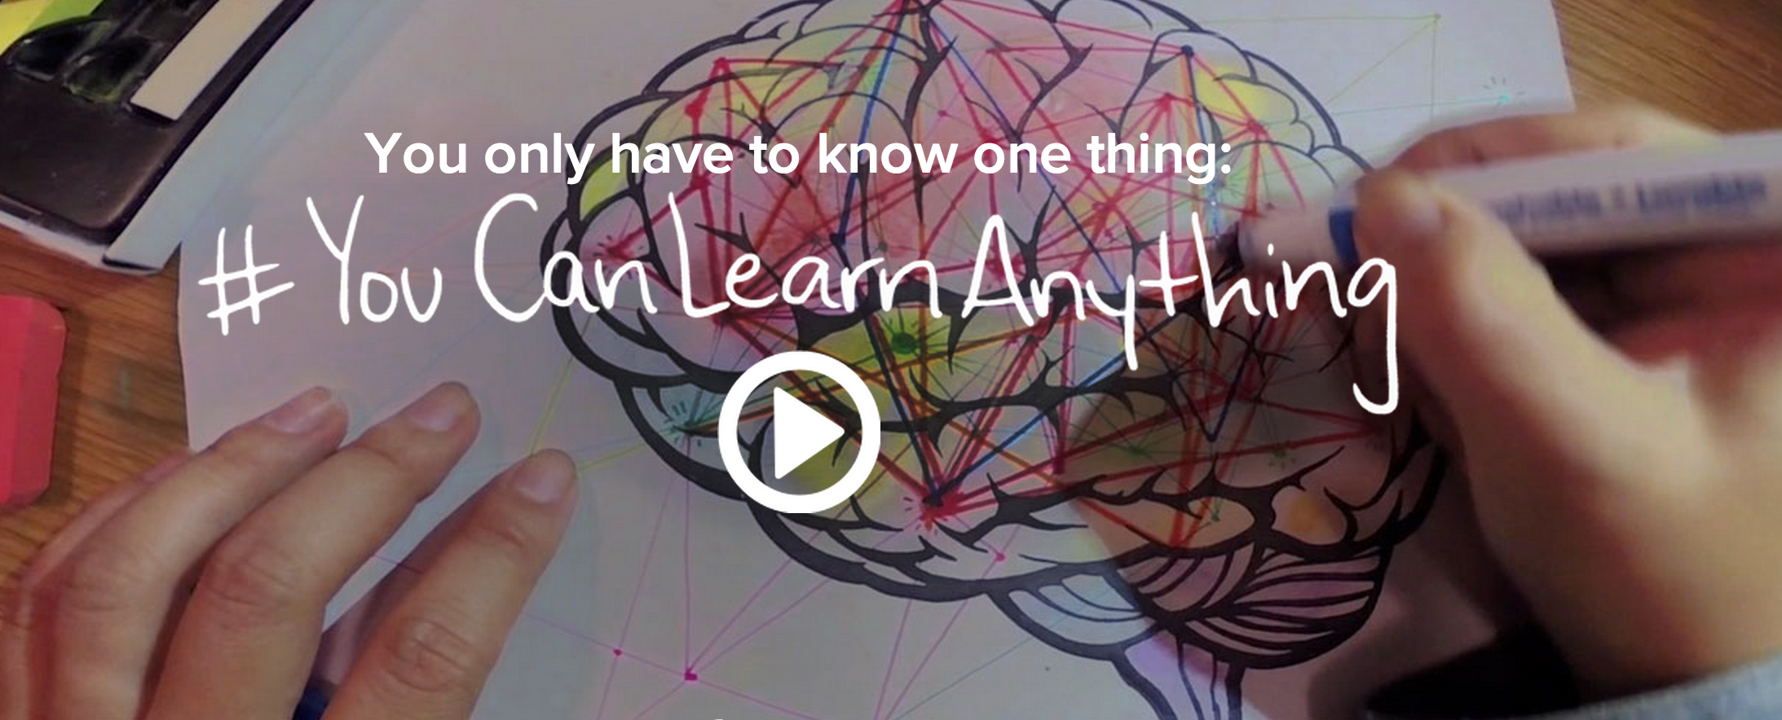
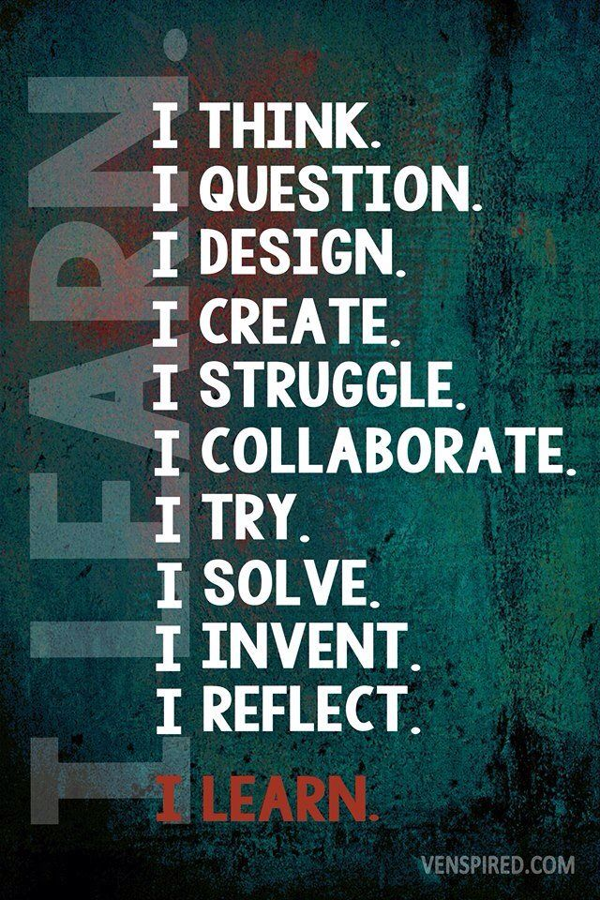
Kim’s Top Tips & Strategies
Model Mindset

Slide 11
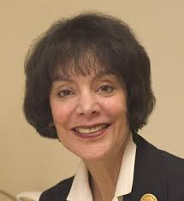
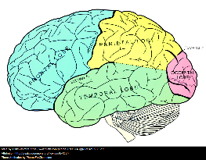
Growth Mindset

Slide 12
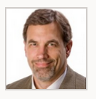
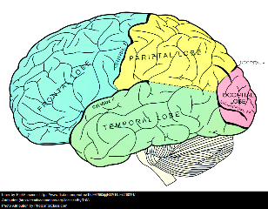
Innovation Mindset
Growth Mindset
Maker
Mindset
Tom Vander Ark
Founder/CEO of Getting Smart
Team
Mindset
I can learn
I can do this
I can reach my goals
I can overcome setbacks
I know myself and what I need to do
I’m interested in learning
I ask, what if?
I ask, why not?
This is important to me
I can create value
I belong here
I appreciate that point of view
I can get the help I need
Self-efficacy &confidence
Goal setting & Managing
Persistence & Resilience
Metacognition
Curiosity
Creativity
Purpose & Relevance Contribution
Social belonging Understanding
Social capital

Slide 13
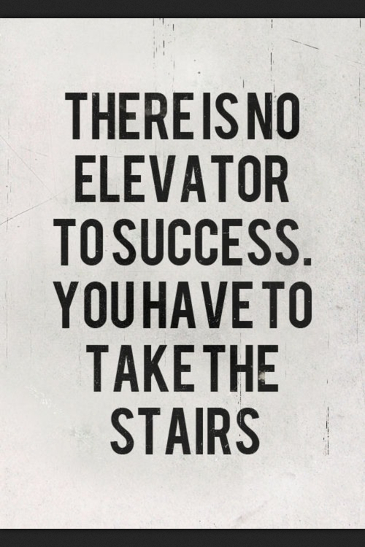
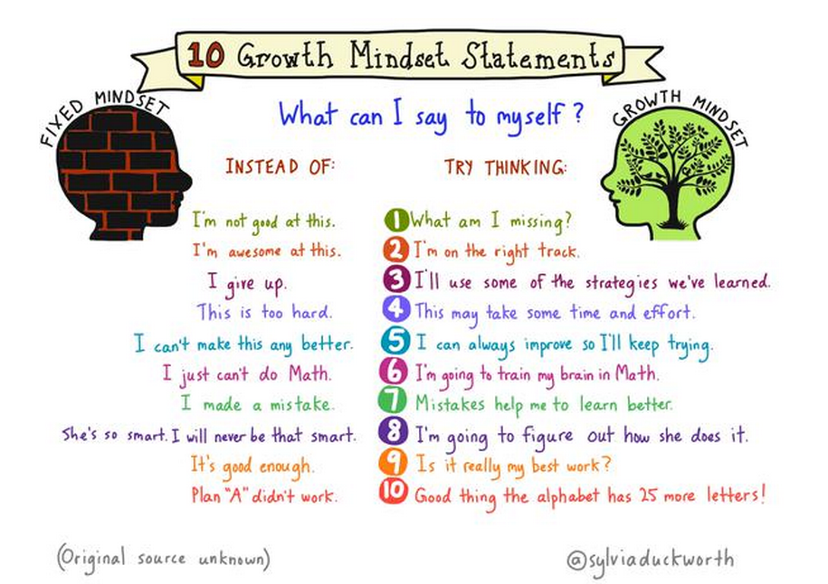
Kim’s Top Tips & Strategies
Model Mindset
Changed “Self-Talk”

Slide 14
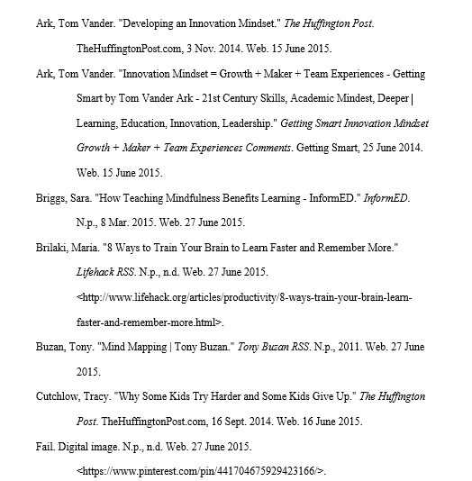
Works Cited

Slide 15
Works Cited, continued

Slide 16
Works Cited, continued

Slide 17
Works Cited, continued

