Slide 1
Make your FIRST Nearpod lesson

Slide 2
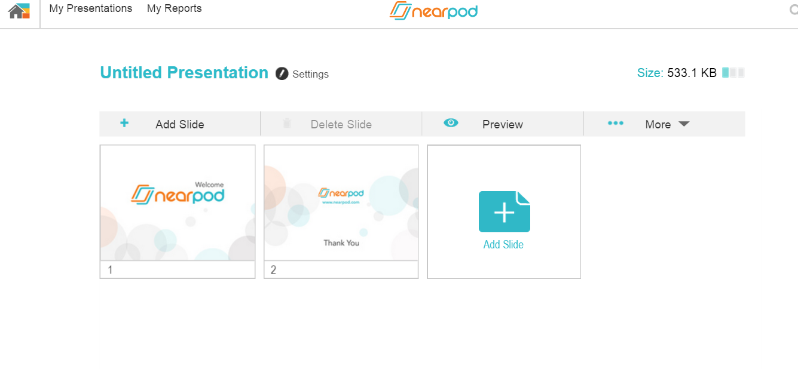
Your new lesson will have a Welcome and End slide
You always “Add slide”
at end.
You can move them around later

Slide 3
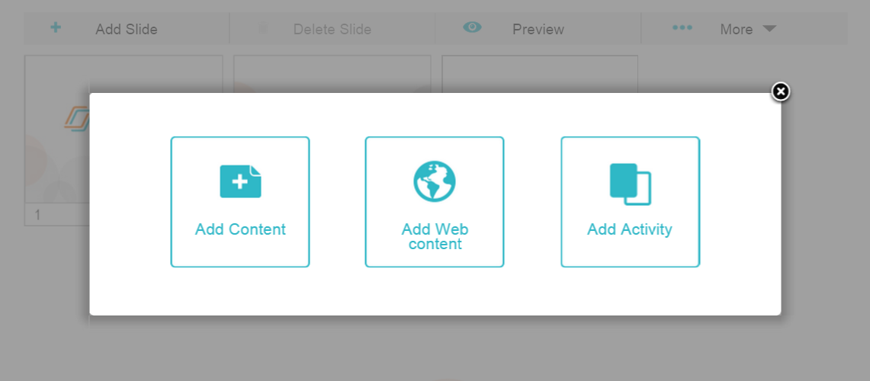
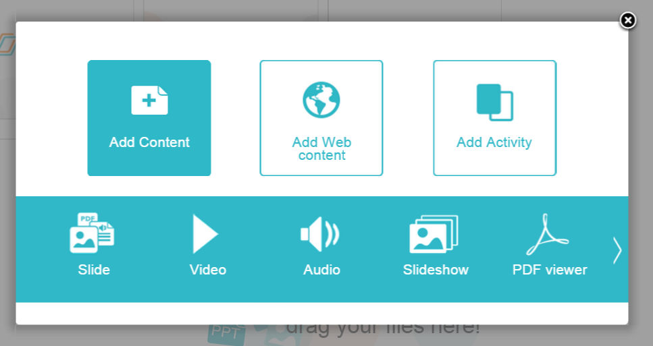
This where you make the “lesson slides”
This is what it looks like AFTER you click Add Content

Slide 4
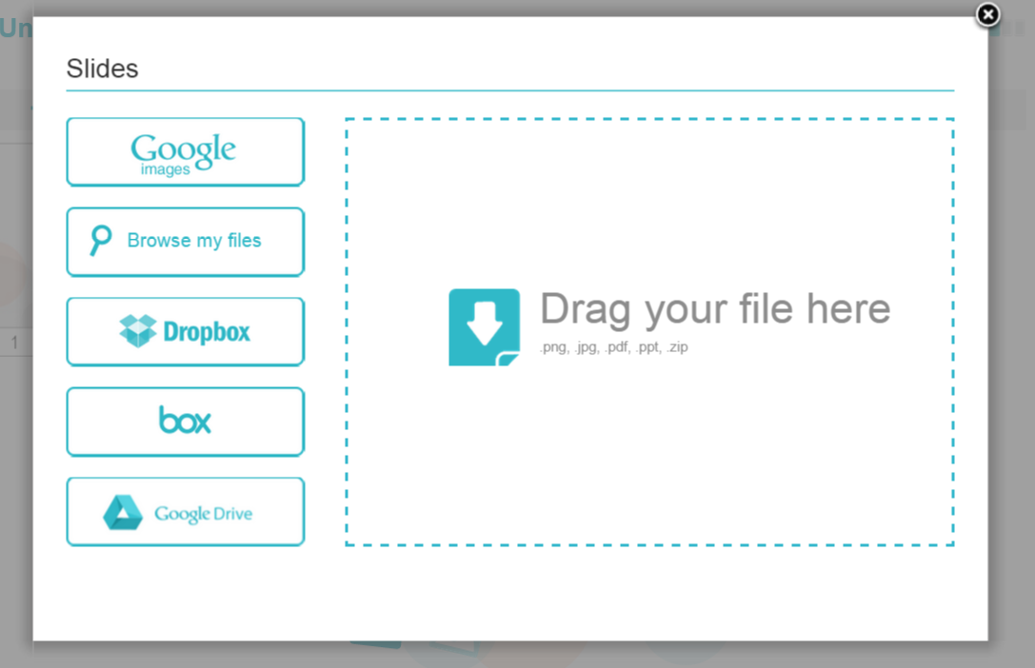
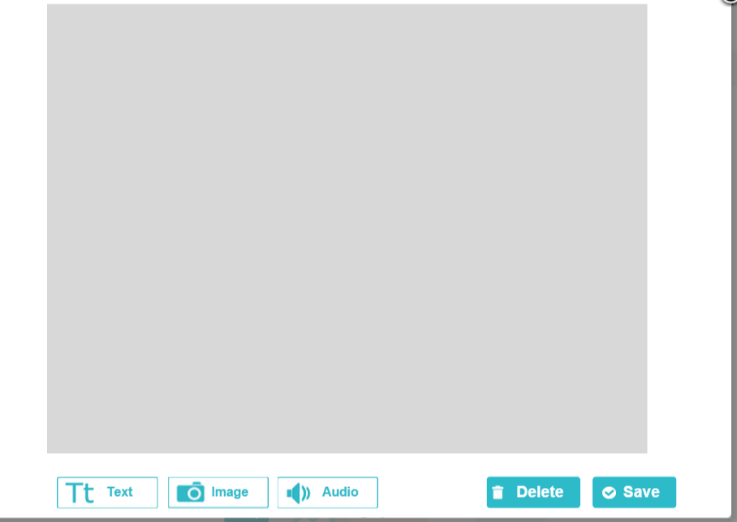
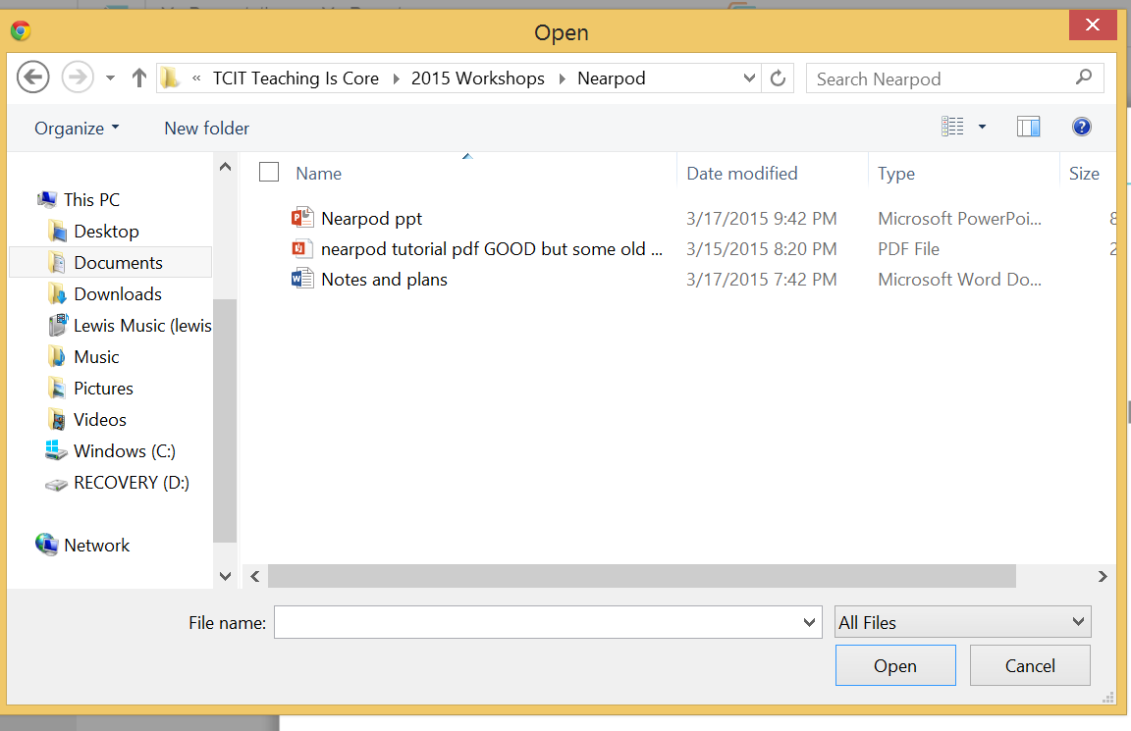
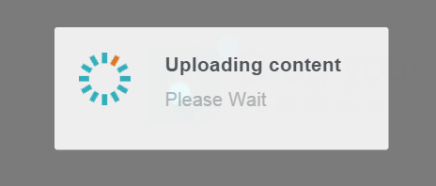
This opens
To “import” PowerPoint slides Click IMAGE Then click here

Slide 5
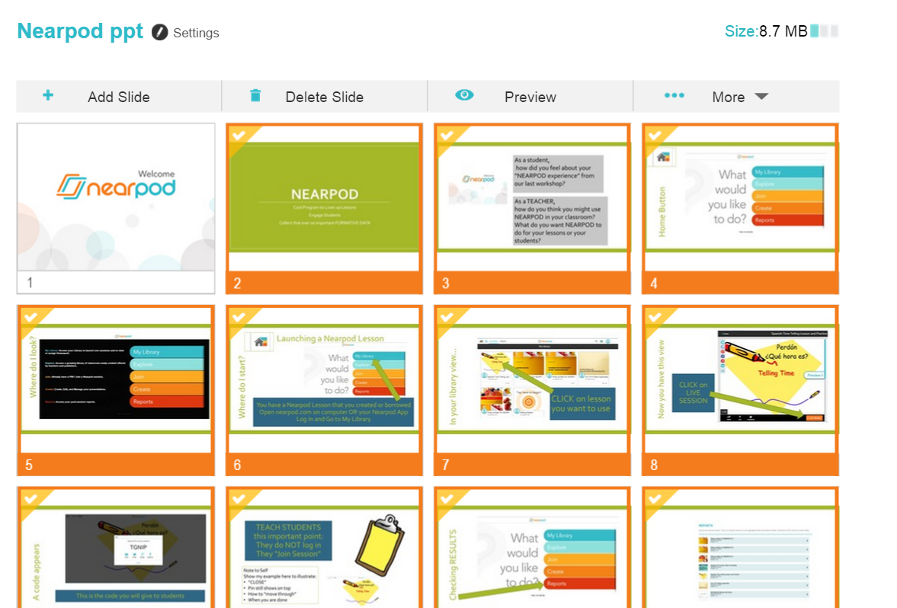
Now your Power Point slides are in your Nearpod
Lesson
You’re ready to add “Activities” (questions) so you will CLICK Add Slide

Slide 6
These are your choices

Slide 7
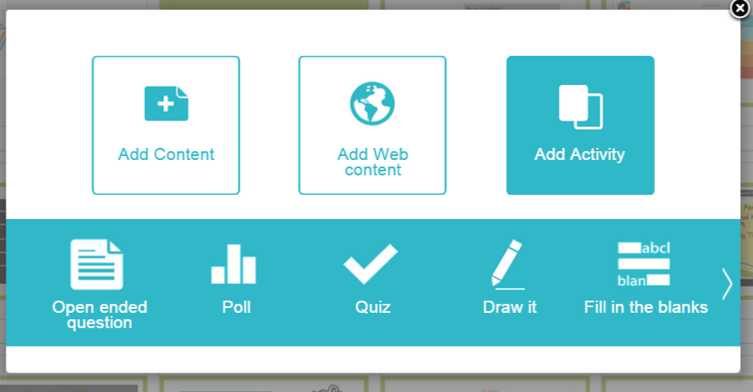
This where you add the questions
This is what it looks like AFTER you click Add Activity

Slide 8
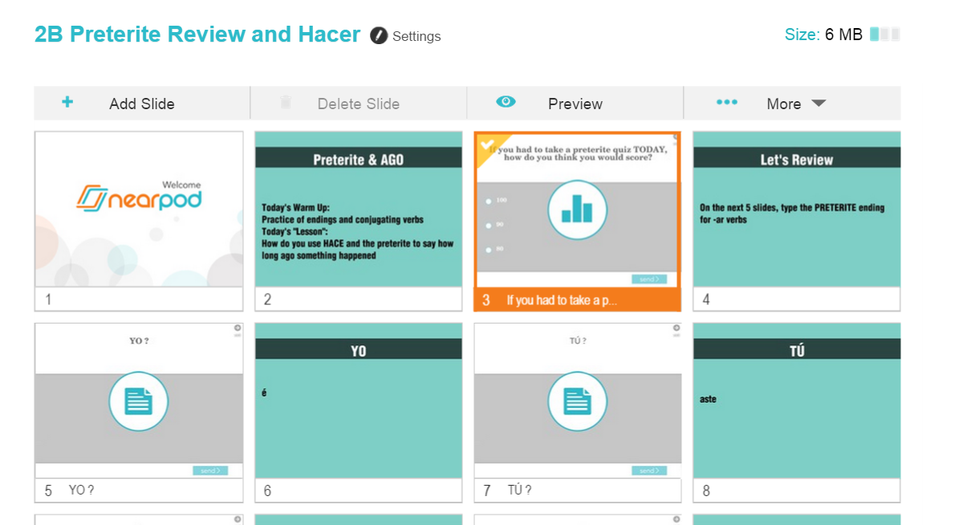
You can also
Delete
a highlighted slide
Click on SLIDE to Highlight so you can Drag to reorder

Slide 9
PUBLISH so you can LAUNCH live session
Don’t forget to PUBLISH when you’re done

Slide 10
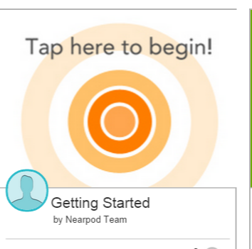
SUPPORT

Slide 11
Nearpod.com/help

Slide 13
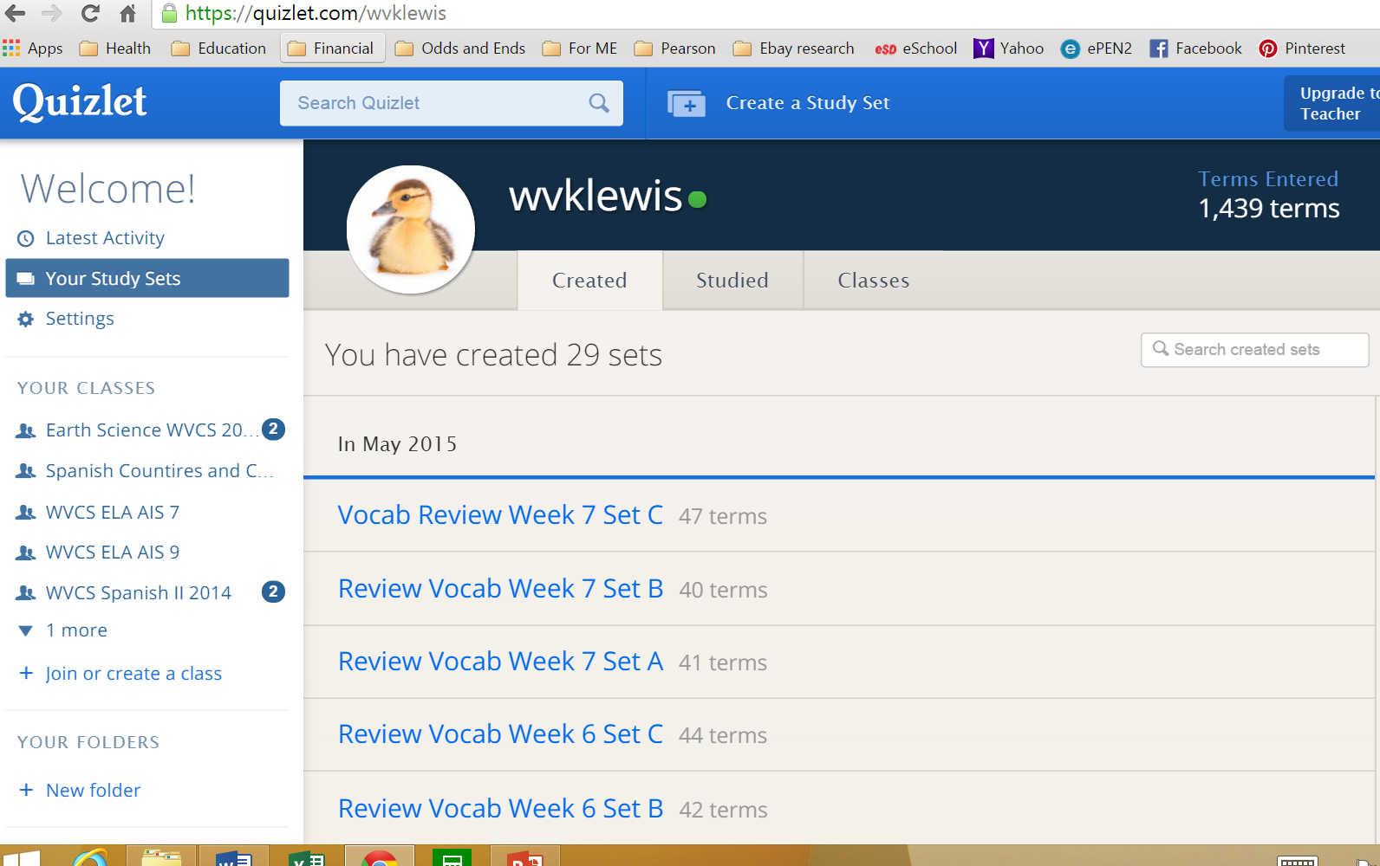
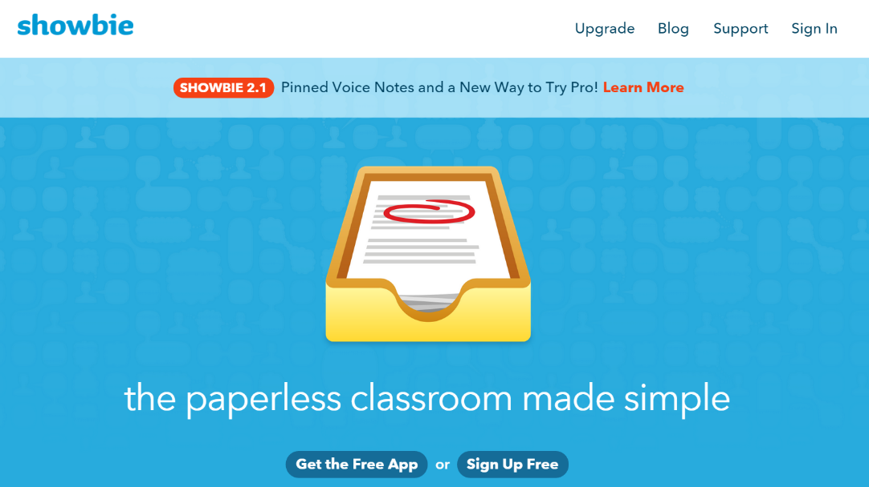
Other TECHIE TOOLS
Upload activity as pdf
Assign to class
Student completes and returns
You give feedback – “write” on screen, comment bubbles
PORTFOLIO
Vocabulary practice with
digital FLASHCARDS etc.
Free
Searchable- use another teacher’s work
Students join CLASS you organize

