Slide 1
Nearpod
NYSMSA June 30, 2015
LOTE Session
Kimberly Lewis
klewis2002@yahoo.com
klewis@wvalley.wnyric.org
716-445-8134
www.akordingtokim.weebly.com
Cool Program to Liven up Lessons
Engage Students &
Collect that ever so important FORMATIVE DATA
(and it works with iPads, laptops, tablets, even Smartphones!)

Slide 2
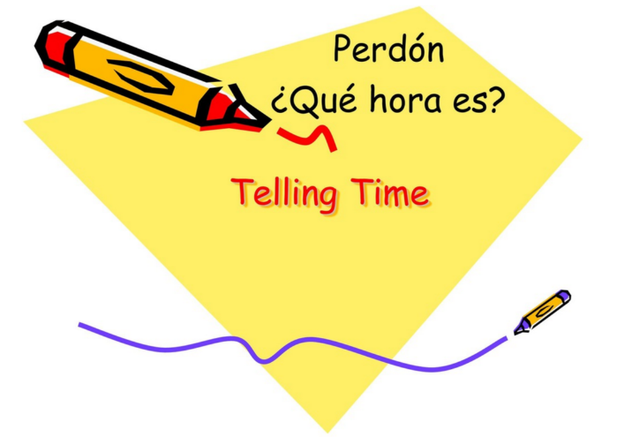
https://www.youtube.com/watch?v=ew_uA44KSjY
Disclaimer…..
There is no “treasure trove” for LOTE in NEARPOD
BUT I can show you how quick & easy it is to make your own .
Click here later for 15 min tutorial
Let’s try one of mine….
Go to www.nearpod.com & JOIN SESSION
DO NOT LOG IN !

Slide 3
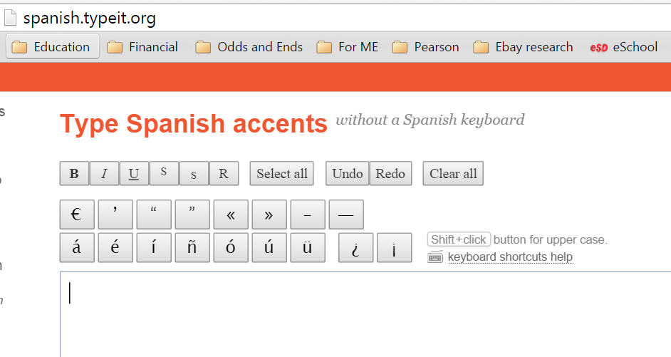
The easiest way to get accents into NEARPOD using laptop is to open a second tab and go to spanish.typeit.org
Copy & Paste into NEARPOD
Let’s learn the basics of using and creating lessons
Look along the left margin FRENCH
Be thinking about how you might use NEARPOD to liven up your lessons & engage your students?

Slide 4
Home Button

Slide 5
Where do I look?

Slide 6
Where do I start?
Launching a Nearpod Lesson
You have a Nearpod Lesson that you created or borrowed
Open nearpod.com on computer OR your Nearpod App
Log In and Go to My Library

Slide 7
In your library view…
CLICK on lesson you want to use

Slide 8
Now you have this view
CLICK on LIVE SESSION for use as whole class lesson
CLICK on Homework if you want to give students a code for “self-paced” activity

Slide 9
A code appears
Click “CLOSE”
Pin still shows on top
Move through with arrow key or SWIPE
This is the code you will give to students

Slide 10
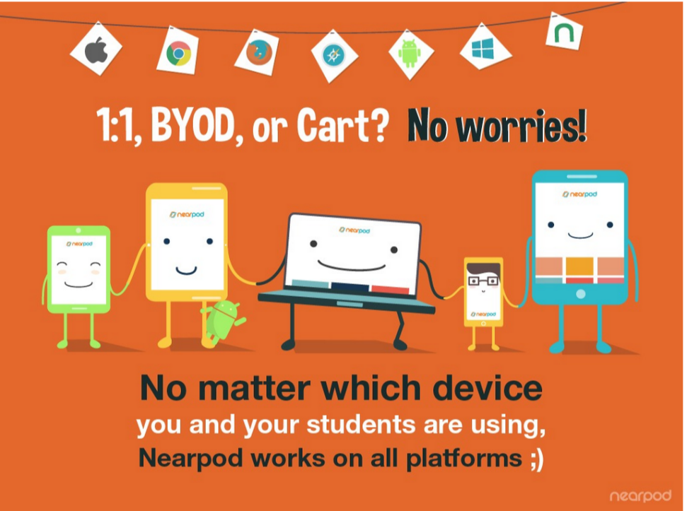
TEACH STUDENTS this important point: They do NOT log in They “Join Session”
Device notes:
Students can be on mixed devices!
On iPads, you can use NEARPOD App or just SAFARI at nearpod.com to join session
On laptops, use CHROME for browser
YOU can launch NEARPOD lesson from iPad or laptop

Slide 11
Checking RESULTS

Slide 13
Click on the session date and time and you get this screen

Slide 14
Individual responses

Slide 15
Editing Presentations

Slide 16
Grid view
PUBLISHED means
“READY TO USE”

Slide 17
List view

Slide 18
TO Edit… you must OPEN

Slide 19
This is what the screen looks like as you create

Slide 20
Don’t worry. More “how tos” on future slides
Don’t forget to PUBLISH when you’re done

Slide 21
You might find a Nearpod to use that’s already been created (if you teach something other than LOTE)

Slide 22
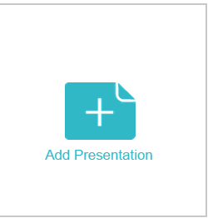
Create your First Nearpod!
Open nearpod.com
on computer
Create an Account
It’s FREE
+ 2 people get
Gold Edition Prize
$120 value
Log In
Go to CREATE

